Slide 1
Convolution Neural Network Models (CNN) Using tf.Keras
Speaker, Date

Slide 3
OUTLINE
Start with FCN
Explain a box and whisker plot
Explain convolution
What is it?
Explain other activation functions
Basic convolution mode (1 CNN)
Batch Normalization with 1 CNN
Deeper CNN model
Visual analysis of model?

Slide 4
Image Problems
Before Neural Networks, image recognition was very difficult
Lots of hand coding
Most codes could be defeated by rotating image or changing colors (or both)
Yann LeCun thought of using the convolution operator as an activation function in a Neural Network model
The use of DNN’s and CNN’s exploded after this

Slide 5
Types of image problems
Classification
Bounding Box
Segmentation
?

Slide 6
MNIST

Slide 7
Object Classification (MNIST)
Object Classification or Recognition (what is the image?)
MNIST dataset was developed by Yann LeCun, Corinna Cortes and Christopher Burges for evaluating machine learning models on the handwritten digit classification problem
Constructed from a scanned document dataset available from the National Institute of Standards and Technology (NIST)
Variety of scanned documents, normalized in size and centered
28 by 28 pixels square (784 pixels total), grayscale (0..255)
60,000 images are used in training, 10,000 images are used to test it
10 digits (0 to 9) or 10 classes to predict
Results are reported using prediction error, which is nothing more than the inverted classification accuracy.
Notes:
https://machinelearningmastery.com/handwritten-digit-recognition-using-convolutional-neural-networks-python-keras/

Slide 8
Object Classification (MNIST)
Excellent results achieve a prediction error of less than 1%
State-of-the-art prediction error of approximately 0.2% with large Convolutional Neural Networks
There is a listing of the state-of-the-art results and links to the relevant papers on the MNIST and other datasets on Rodrigo Benenson’s webpage

Slide 9
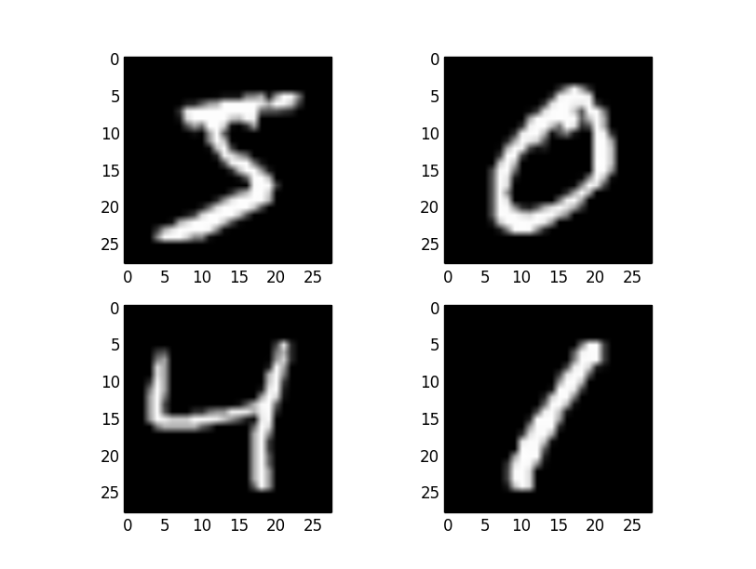
Load Data – Sample Output

Slide 10
Single Perceptron Layer

Slide 11
Single Layer Perceptron Model
Let’s use what we learned - Fully Connected Networks (FCN)
Start with a single layer Perceptron
Can it do image recognition?

Slide 12
import numpy
Import tensorflow as tf
(train_x, train_y), (test_x, test_y) =
tf.keras.datasets.mnist.load_data ()
train_x = train_x.astype('float32') / 255
test_x = test_x.astype('float32') / 255
print("Training data, X shape = ", train_x.shape)
print("Training data, y shape = ", train_y.shape)
print("Test data, x shape = ", test_x.shape)
print("Test data, y shape = ", test_y.shape)
train_x = train_x.reshape(60000,784)
test_x = test_x.reshape(10000,784)
train_y = tf.keras.utils.to_categorical (train_y,10)
test_y = tf.keras.utils.to_categorical (test_y,10)
Keras already has MNIST available
60,000 images and labels for training
10,000 images and labels for testing
Converted to Numpy arrays
Convert 28x28 array to 1D vector (784)
Convert labels to categories (10 of them)

Slide 13
Create Model
# create model
model = tf.keras.models.Sequential()
model.add(tf.keras.layers.Dense(num_pixels,
input_dim=num_pixels, kernel_initializer='normal’,
activation='relu'))
model.add(tf.keras.layers.Dense(num_classes,
kernel_initializer='normal’
activation='softmax'))
# Compile model
model.compile(loss='categorical_crossentropy’,
optimizer='adam', metrics=['accuracy'])
model.summary()
return model
# end def
model = Sequential()
model.add(Dense(units=128,activation="relu",input_shape=(784,)))
model.add(Dense(units=10,activation="softmax"))
model.compile(optimizer=‘adam’,loss="categorical_crossentropy",metrics=["accuracy"])
# Model.summary
print("Model Summary:")
model.summary()
print(" ")
One FCN layer
128 neurons
Use softmax for output layer
Great for classifications
Print out model
model.summary()

Slide 14
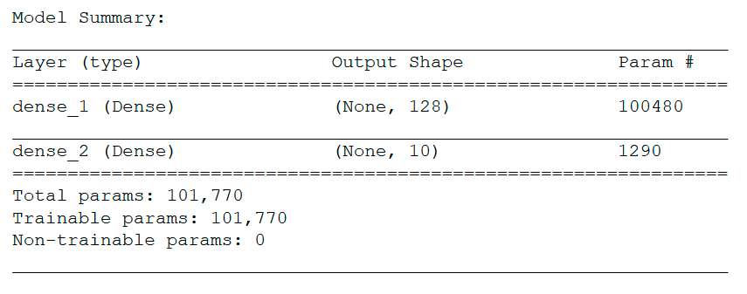
Create Model

Slide 15
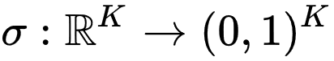
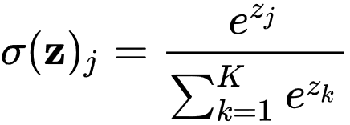
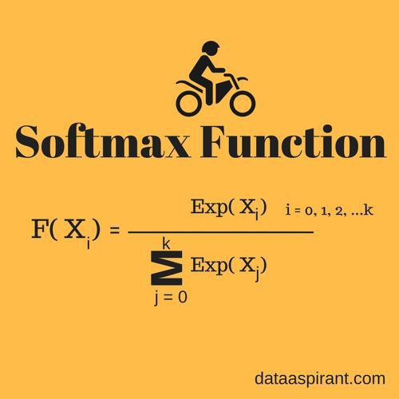
Activation Function - Softmax
In mathematics, the softmax function, or normalized exponential function, is a generalization of the logistic function (In Keras, ‘softmax’)
Neural Networks are commonly trained under a log loss (or cross-entropy) regime
Probabilities will be in range of 0 to 1
Sum of all probabilities is 1

Slide 16
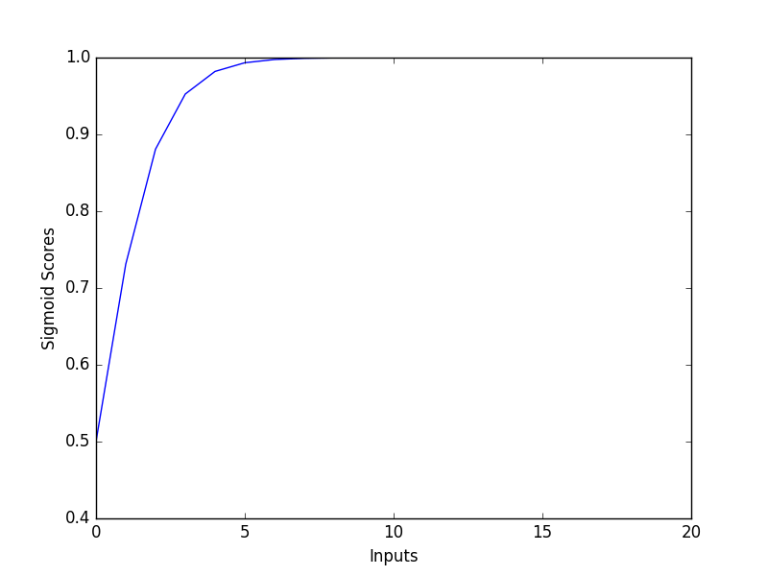
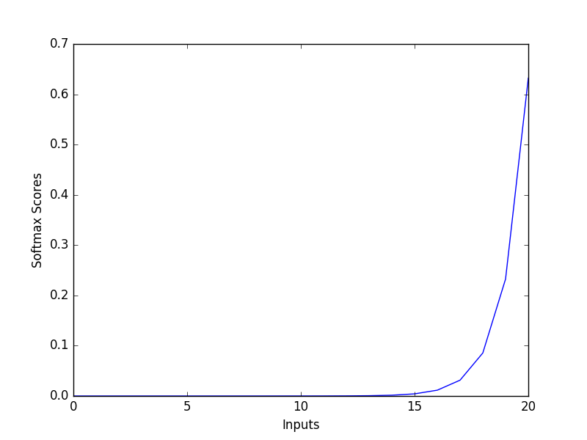
Activation Function - Softmax

Slide 17
TRAIN
Collect training history
Batch size of 32
10 Epochs (just a start)
Compute total training time
Evaluate accuracy of test images
Print out accuracy of first image
# Train
import time
start_time = time.time()
history = model.fit(train_x,train_y, batch_size=32,
epochs=10, verbose=1)
end_time = time.time()
accuracy = model.evaluate(x=test_x,y=test_y,batch_size=32)
print("Accuracy: ",accuracy[1])

Slide 18
POST-PROCESSING
Plot accuracy and loss history
Print out total training time
import matplotlib.pyplot as plt
plt.plot(history.history['acc'])
plt.title('model accuracy')
plt.ylabel('accuracy')
plt.xlabel('epoch')
plt.legend(['train'], loc='upper left')
plt.show()
# summarize history for loss
plt.plot(history.history['loss'])
plt.title('model loss')
plt.ylabel('loss')
plt.xlabel('epoch')
plt.legend(['train'], loc='upper left')
plt.show()
# total training time
print(" ")
print("Total training time = ",(end_time - start_time)," seconds")

Slide 19
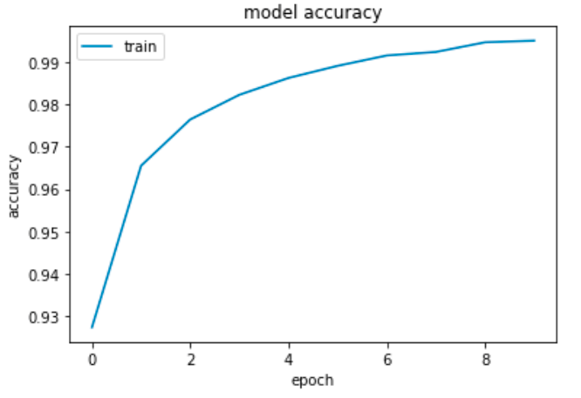
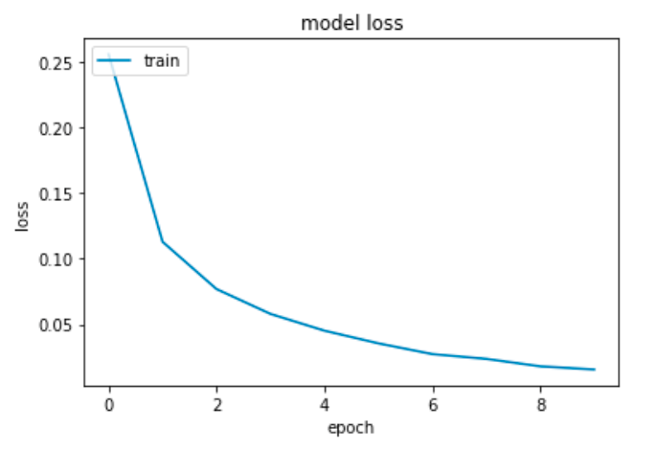
POST PROCESSING

Slide 20
Longer training
Try longer training
100 Epochs
What happened?
Training data:
Loss = 0.002 (started at 0.281)
Accuracy = 0.999 (started at 0.919)
Validation data:
Loss = 0.168 (started at 0.212)
Accuracy = 0.982 (started at 0.957)
Over-trained?

Slide 21
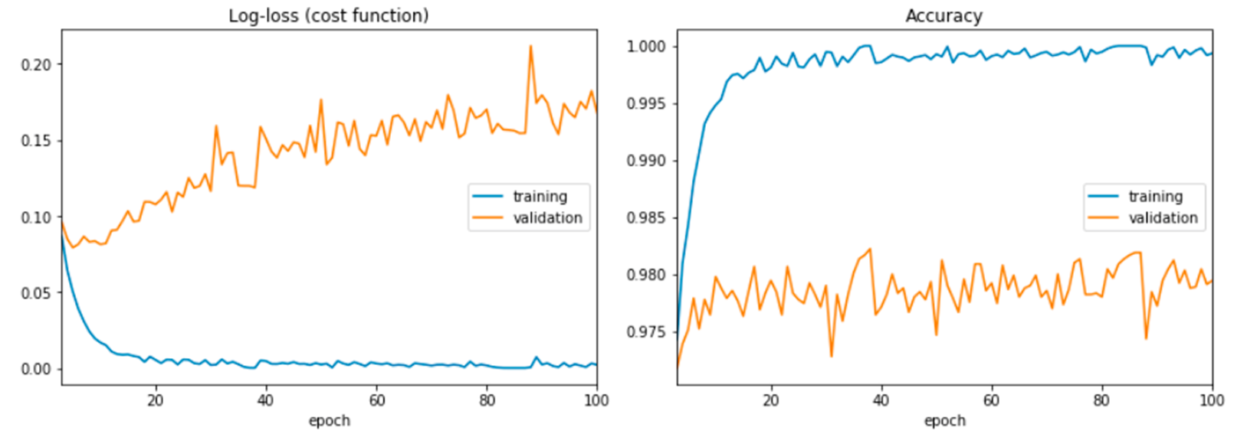
AFTER 100 EPOCHS

Slide 22
Summary
After 10 epochs
About 99.5% accuracy (started at about 92.7%)
Loss of less than 0.0157 (started a bit above 0.255)
What happens with a longer training time?
Training data:
Loss = 0.002 (started at 0.281)
Accuracy = 0.999 (started at 0.919)
Validation data:
Loss = 0.168 (started at 0.212)
Accuracy = 0.982 (started at 0.957)
Over-fitting?
Notes:
https://machinelearningmastery.com/handwritten-digit-recognition-using-convolutional-neural-networks-python-keras/

